Slide 1
Publishing in an International Journal
Laura A. Janda (http://hum.uit.no/lajanda/)
CLEAR Group
(Cognitive Linguistics: Empirical Approaches to Russian)

Slide 2

Overview
History, Mission, Status of Cognitive Linguistics
Current editorial structure
Processing of submissions
How to get published: NGU

Slide 3
1. History and Mission of Cognitive Linguistics
Founded in 1989, Mouton de Gruyter, 4 issues/year
Mission statement:
Cognitive Linguistics presents a forum for high-quality linguistic research on topics which investigate the interaction between language and cognition. We publish articles that focus on topics such as:
  the structural characteristics of natural language categorization (such as prototypicality, cognitive models, metaphor, and imagery)
  functional principles of linguistic organization (such as iconicity)
  the conceptual interface between syntax and semantics
  the relationship between language and thought, including matters of universality and language specificity
  the experiential background of language-in-use, including the cultural background, the discourse context, and the psychological environment of linguistic performance

Slide 4
1. Status of Cognitive Linguistics
INT1 Sub-Category (highest level) in the European Science Foundation’s Reference index for the humanities
  “international publications with high visibility and influence among researchers in the various research domains in different countries, regularly cited all over the world”
Current Scientific Journal Ranking: Top Quartile worldwide (0.846), H index = 15
Niveau 2 (highest level) in Norwegian CRISTIN system
Abstracted/indexed in 20 international bibliometric databases

Slide 5


2. Current editorial structure
Editor-in-Chief (Ewa Dabrowska) through 2013, John Newman from 2014
Editorial Assistant
6 Associate Editors (Alan Cienki, Holger Diessel, Mirjam Fried, Stefan Th. Gries, Laura A. Janda, John R. Taylor)
Review Editor (Martin Pütz)
Editorial Board (30 members, includes people like Harald Baayen, Joan Bybee, William Croft, Dirk Geeraerts, Adele Goldberg, Martin Haspelmath, Ronald Langacker, Dan Slobin, Elizabeth Traugott)

Slide 6
3. Processing of submissions
In 2014 we converted to Scholar One
Submission is received and assigned an ID#, author receives that number with an acknowledgement
Editor rejects or assigns submission to an Associate Editor
Assistant sends submission to Associate Editor to recommend either rejection or review
If Associate Editor recommends rejection, s/he writes a report and consults with Editor
If Associate Editor recommends review, s/he suggests at least 3 possible reviewers in each of these categories: Board, Area 1, Area 2(/language) [see next slide]
Assistant contacts suggested reviewers; goal is to get one from each group to agree to write a review within one month
Usually we get 3 reviews this way, but sometimes a reviewer fails to live up to their promise and we get only 2, in which case the Associate Editor often serves as the third reviewer

Slide 7
3. Processing of submissions
Sources for reviewers:
  scholars I know who have done similar research
  scholars listed in the references
  scholars not listed in the references who should have been
  scholars in the field that I can find on websites for recent conferences, professional organizations, etc.

Slide 8
3. Processing of submissions
Assistant sends reviews to Associate Editor
Associate Editor reads reviews and submission and writes a report recommending: reject, revise & resubmit, or accept pending revisions
Editor evaluates submission and reviews and Associate Editor’s report and writes a report/cover letter to author
Assistant sends author Editor’s letter/report, AE’s report, and all reviews.
If author submits a revised version, Editor reviews this, usually in consultation with Associate Editor and some resubmissions may be sent out to reviewers again
After a revised version is accepted, it is queued for publication and the author will receive proofs

Slide 9
3. Processing of submissions
Number of submissions has been rising:
2001-2003: 88 in total (average 29/year)
2004: 49
2005: 44
2006: 58
2007: 87
2008: 70
2009: 96
2010: 100
2011: 108
2012: 113

Slide 10

3. Processing of submissions
What we are looking for
Ideally a submission should present:
  authentic data
  representing a new phenomenon,
  a new methodology for analysis, and
  a theoretical contribution to cognitive linguistics
There are many types of excellent studies
that deserve to be published,
but cannot be published in Cognitive Linguistics
because they do not meet these criteria

Slide 11
3. Processing of submissions
There are 4 categories – what do you think the distribution is?
  reject without review
  reject after review
  revise & resubmit
  accept pending revisions

Slide 12
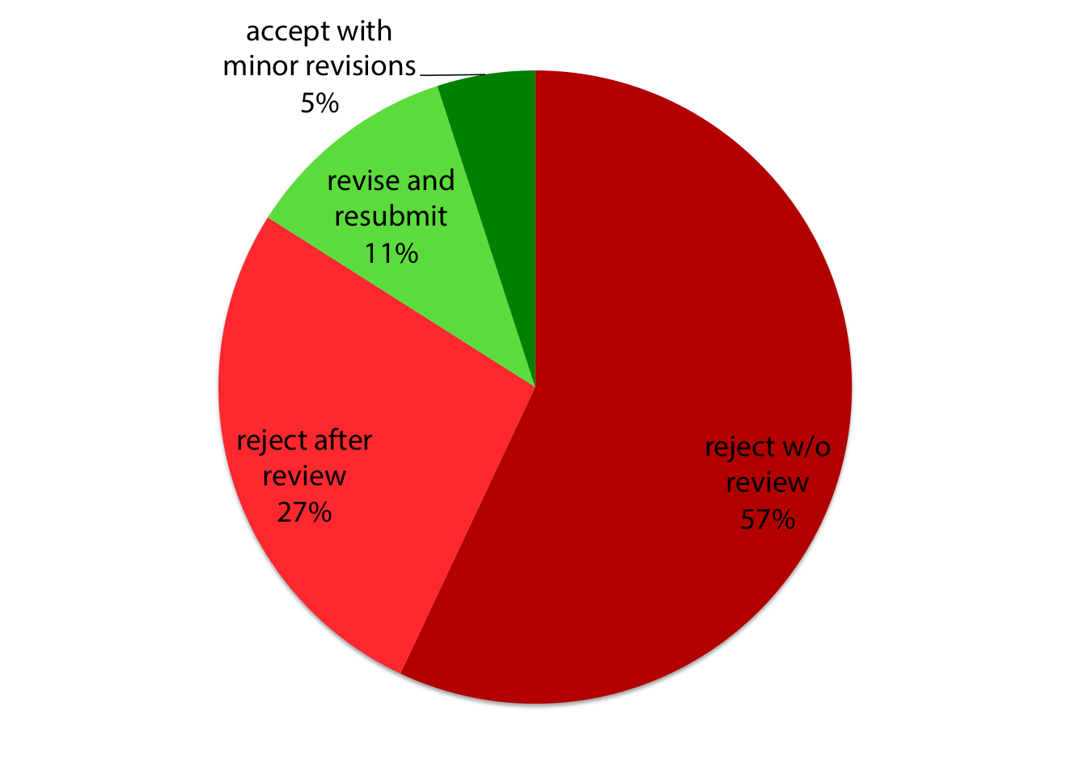
2011 statistics
(108 submissions - 23 status still pending)

Slide 13
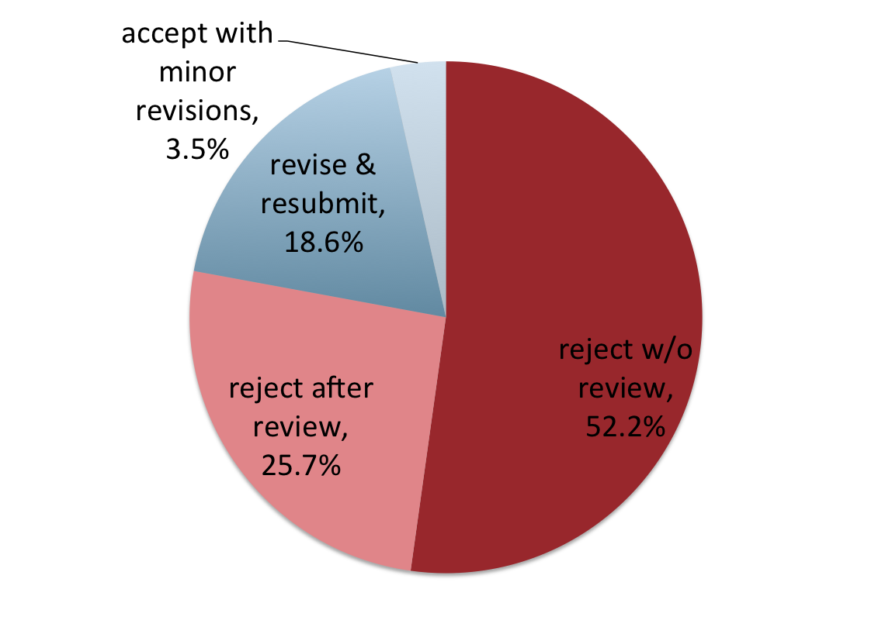
2012 Submissions
(total of 113)

Slide 14
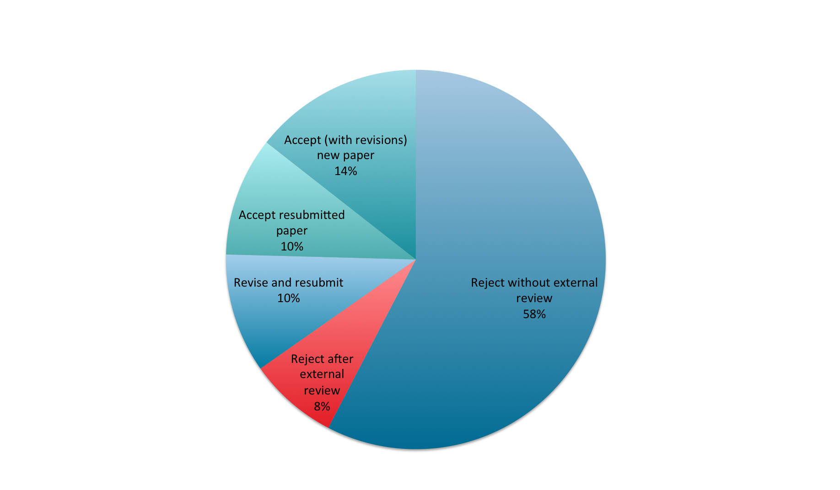
2014 Submissions
(out of 118 total)
Over a third of the
articles accepted in
2014 were part of
a special issue that
went through a prior
peer review process

Slide 15
3. Processing of submissions
Reasons for rejection
  Over half of rejections involve failure to make an adequate connection to cognitive linguistics (this is especially true of submissions rejected without review)
  Other reasons for rejection: no new data/theory, primarily descriptive, problems with theory/data/argumentation, weak references/statistics/English, far-fetched idea

Slide 16
3. Processing of submissions
I write a lot of rejection letters, which typically contain:
  recognition of the submission’s merits/potential, encouragement to continue the line of research
  suggestion of theoretical angles that could be relevant
  citation of relevant existing works that could be useful to the author
  suggestion of types of corpus/experimental data that could support the argument
  suggestion of other publication venues that might be more appropriate

Slide 17
4. How to get published: NGU
Can you guess what is the one biggest mistake many authors make (in my humble opinion)?
They don’t revise and resubmit!
This is one example of failing to follow my motto: NGU
NEVER GIVE UP!
The next few slides detail my advice for success in academic publishing...

Slide 18
4. How to get published: NGU
Before you write your paper, think about what journal(s) you might send it to, and write it with the corresponding audience in mind.
While you are working on the paper, present it at a conference and get (and use!) feedback.
Before sending your paper to a journal, send it to some relevant colleagues and ask for their comments. Revise your paper according to these comments before you submit it. If you are brave enough, send it to a colleague who has published a different point of view on the topic.
If you are not a native speaker of English, have a colleague who is read through your manuscript and make corrections before you submit it.
Make your submission anonymous.

Slide 19
4. How to get published: NGU
If you are considering a certain journal, take a look at a few issues and/or check through an index. See whether they publish articles on topics like yours. If not, look for another journal.
Write to the editor of the journal and tell him/her what your topic is and ask whether it might be appropriate to submit your paper to that journal.
Be very sure that you engage relevant works written by members of the target audience. Don’t just pay lip service, really study them and integrate them into your work.
Be aware that the people that you cite, particularly those that you argue against, are likely to be contacted as reviewers.
Look up all information for contributors and follow instructions carefully. Make sure that the formatting of citations and references matches the style of the journal.

Slide 20
4. How to get published: NGU
If you get rejected:
  Read carefully through the comments.
  If you think you can make revisions that will satisfy all the criticism, you can tell the editor that you’d like to resubmit. The editor might tell you that you will have to send it as a new submission. Or s/he might even let you resubmit. Then follow the instructions below for revise & resubmit.
  The other option is to send the article to another journal. But before you do that, try to revise the manuscript by integrating all of the comments you got. This way you have a better chance of avoiding rejection from the next journal too.

Slide 21
4. How to get published: NGU
If you get revise & resubmit:
  Rejoice! This is usually the best possible outcome.
  It may involve a lot of comments that look really nasty at first, but now you are on your way to publication.
  You can basically treat the reviews like a contract: If you do your part and make all the suggested revisions, it is very likely that your paper will be published.

Slide 22
4. How to get published: NGU
How to revise and resubmit:
  Take your time and do any extra research that may be needed
  Write a cover letter that lists all of the comments made by the reviewers and editors and details how they were integrated into your resubmission, listing page numbers in your original and revised versions. Use highlighting to show where the revisions are in the resubmission.
  Optional: Acknowledge the contributions of the reviewers and editors in a footnote

Slide 23
4. How to get published: NGU
Things NOT to do:
  Don’t send a manuscript to more than one journal at the same time.
  Don’t complain to the editor or disparage the reviewers – they do this as a service to the profession; politeness will get you farther than spite.
  Don’t ask the editor to interpret comments that you find vague or problematic. For example, if a reviewer says that your paper “lacks focus”, don’t demand clearer directions; you are supposed to figure out what to do (in this case, try to state your main points more clearly at the beginning of the paper and make sure they are emphasized throughout).

Slide 24

4. How to get published: NGU
Some advice:
  Keep several projects cooking at once. That way, as soon as you submit one paper, you forget about it until you hear back and can turn to another project.
  Also, if you have various submissions in various stages at various journals, you are likely to have some successes to balance out the inevitable rejections.
  And remember that even a rejection doesn’t mean that it is time to give up!

Slide 25

Start an internal peer-review group!
Before sending an article to a journal, send it to your group and hold a meeting to critique the manuscript.
Leave your ego outside the room and don’t take anything personally.
Critique should be merciless, don’t worry about being polite.
Fully revise the manuscript to reflect all the critique before sending it to the journal.

